Slide 1
Exam 70-774 Perform Cloud Data Science with Azure Machine Learning
Prepare Data for Analysis in Azure Machine Learning and Export from Azure Machine Learning
Develop Machine Learning Models
Operationalize and Manage Azure Machine Learning Services
Use Other Services for Machine Learning
Speaker Information:
https://www.microsoft.com/en-ie/learning/exam-70-774.aspx
Notes:
20533D
1: Introduction to Microsoft Azure

Slide 2
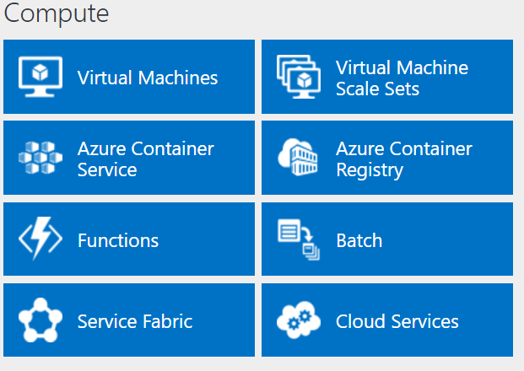
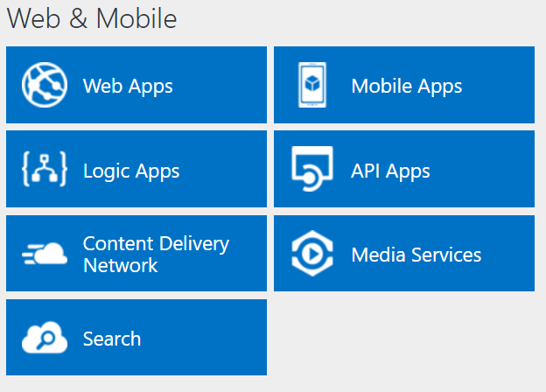
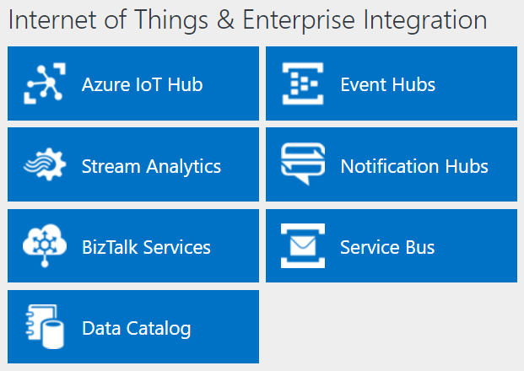
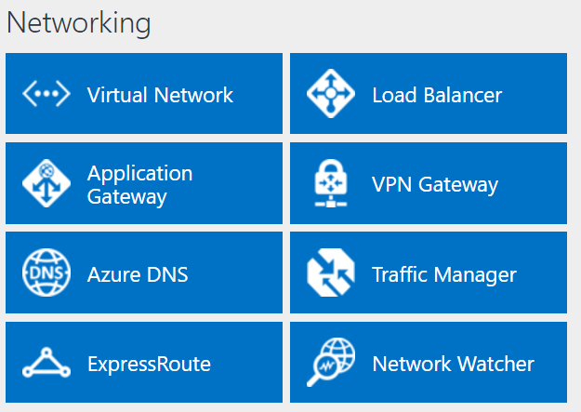
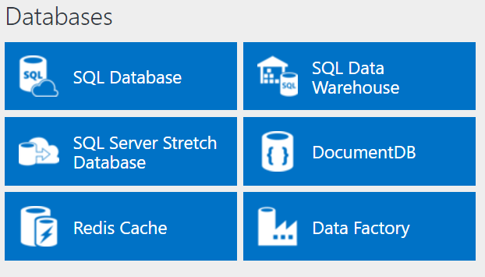
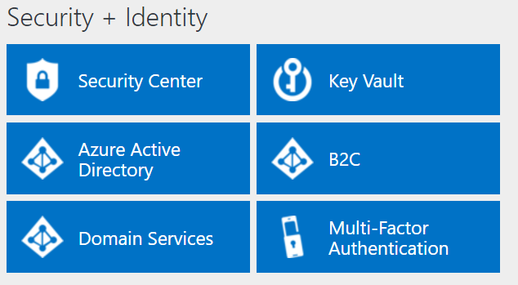
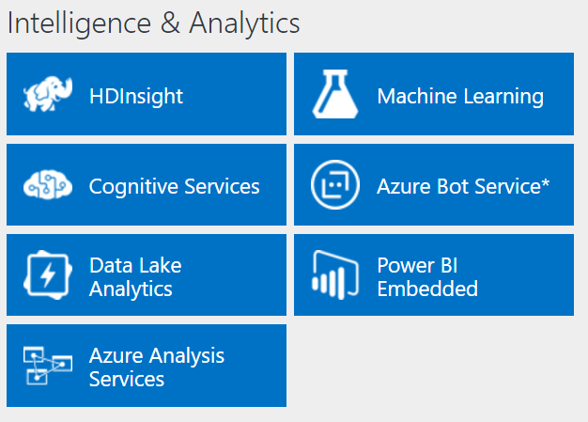
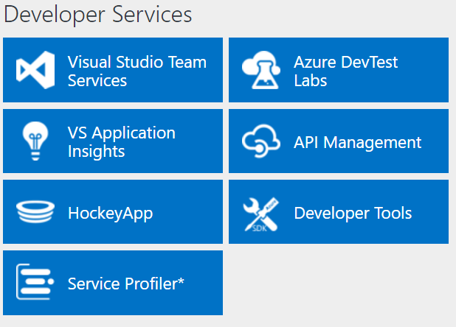
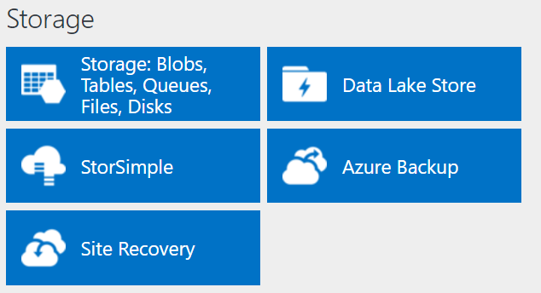
http://azureplatform.azurewebsites.net/
* Preview Services
Notes:
Preview Version 1.7 (2017-04-20)

Slide 3
Prepare Data for Analysis in Azure Machine Learning and Export from Azure Machine Learning
What is machine learning?
Introduction to machine learning algorithms
Introduction to machine learning languages
https://www.microsoft.com/en-ie/learning/exam-70-774.aspx

Slide 4
What is machine learning?
Machine learning overview How machine learning fits into data science Machine learning concepts and methodologies Models

Slide 5
What is machine learning?
Machine learning overview How machine learning fits into data science Machine learning concepts and methodologies Models
Notes:
20774A
1: Introduction to Machine Learning

Slide 6
Machine learning overview
Machine learning:
Detecting patterns and trends
Statistical analysis
Creating software models
Examples:
Predicting success of medical intervention
Identifying airplane maintenance
Identifying fraudulent financial transactions
Recommending books or movies
Notes:
Statistical analysis, and the use of statistical models to make predictions based on historical data and trends.
For example, if you wish to build a system that can identify human faces in photographs, you provide large numbers of images where those images that do contain faces are identified as such. The system then extracts whatever features in the images are in common to those faces. You shouldn’t try to define a face and provide a definition to the computer system.
20774A
1: Introduction to Machine Learning

Slide 7
How machine learning fits into data science
Key questions:
Is something X or Y?
What is likely to be the numerical value of X or Y?
Is something out of the ordinary or unexpected?
How is this data structured?
Notes:
for yes/no questions some form of classification algorithm is typically used
Some form of regression algorithm is typically used, looking for correlations between items in a dataset.
some form of anomaly detection algorithm or API is typically used.
some form of clustering algorithm is often used, at least as a starting point to help interpret the data.
such as engine parts that fail in a similar way or after a similar period of time
20774A
1: Introduction to Machine Learning

Slide 8
Machine learning concepts and methodologies
Key steps:
Obtain raw data
Preprocess the data
Prepare the data
Apply one or more machine learning algorithms to the data
Determine the best model to use
Deploy the model
Notes:
Preprocess the data: extract just the features you're interested in, or to remove unnecessary noise from the data.
Prepare the data: you might need to add labels to the data, change numerical formats, and so on.
it is the processing and preparing of the data that takes the most time, and presents the most challenges
Within Machine Learning, you use various modules as part of this data preparation step; you can also use code written in R or Python to perform data preprocessing steps.
20774A
1: Introduction to Machine Learning

Slide 9
Models
Machine learning model: the code generated after an algorithm has been run
Training models:
Experiments
Evaluation
Deploying models:
Applications
Retraining
Notes:
The code is, therefore, the set of instructions that successfully solved the problem when run against the training dataset.
Note that the evaluation process needs to be run against a different set of data than that used to initially train the model. It is quite common to use a proportion of your initial dataset, such as 75 percent, for the initial training, and then to use the remaining 25 percent during the evaluation and testing phase.
It is important to note that, typically, a model is unlikely to return an absolute answer; where 0.9 is a very likely yes, and 0.1 a very likely no
there will also be a continuous process of post-deployment evaluation, to make sure that your deployed application continues to produce good results, against new data.
20774A
1: Introduction to Machine Learning

Slide 10
Out of the following machine learning phases, which two take the most time after you have obtained the raw data?
Preprocess the data
Prepare the data
Apply one or more machine learning algorithms to the data
Determine the best model to use
Deploy the model

Slide 11
Preprocess the data
Prepare the data

Slide 12
Introduction to machine learning algorithms
Algorithms overview Classification algorithms Regression algorithms Clustering Supervised and unsupervised learning Anomaly detection Demonstration: Using two-class classification in a machine learning model
Notes:
20774A
1: Introduction to Machine Learning

Slide 13
Algorithms overview
Algorithm: set of steps, methods, or actions
Classification algorithms: yes/no questions, or identify most likely outcome from multiclass list
Regression algorithms: make predictions of outcomes, based on historical patterns
Clustering algorithms: identify groupings within dataset
Notes:
An algorithm is the set of steps that is run against a training dataset as part of the process of generating a machine learning model.
Classification algorithms—used for yes/no questions, or to identify the most likely outcome from a multiclass list where there are more than two possibilities. Classification algorithms will create a model that processes a dataset, and identify which of two or more predefined categories that data represents.
Regression algorithms—typically used to make predictions of outcomes, based on historical patterns. Regression algorithms will create a model that uses historical data, and then identifies relationships between values in that data to make accurate predictions for the future.
Clustering algorithms—used to examine large input datasets, and identify clusters or groupings within that data. You use clustering to create a model that can take a new piece of data and assign or allocate that data to the appropriate cluster for further action or processing.
20774A
1: Introduction to Machine Learning

Slide 14
Classification algorithms
Two-class classification algorithms:
Averaged Perceptron
Bayes Point Machine
Boosted Decision Tree
Decision Forest
Decision Jungle
Locally Deep Support Vector Machine
Logistic Regression
Neural Network
Support Vector Machine
Multiclass classification algorithms:
Decision Forest
Decision Jungle
Logistic Regression
Neural Network
One-vs-All Multiclass
Notes:
The output from a classification algorithm is known as a classifier
Two-class (or binary) classification algorithms are used for yes/no or true/false questions
Multiclass classification algorithms are used where the result of the question will come from a list of potentially two or more two possible outcomes.
20774A
1: Introduction to Machine Learning

Slide 15
Regression algorithms
Regression algorithms:
Bayesian Linear Regression
Boosted Decision Tree Regression
Decision Forest Regression
Fast Forest Quantile Regression
Linear Regression
Neural Network Regression
Ordinal Regression
Poisson Regression
Notes:
Regression algorithms are used to predict values, based on previous data.
20774A
1: Introduction to Machine Learning

Slide 16
Clustering
Clustering:
Often used during the initial stages of mode development
Detects patterns and anomalies
Example:
K-Means Clustering
Notes:
Clustering algorithms are used to find groupings within a dataset, based on common features, such as text containing common words during text analysis.
Clustering is useful during the initial stages of exploring data, to find patterns and identify anomalies in the data.
20774A
1: Introduction to Machine Learning

Slide 17
Supervised and unsupervised learning
Supervised learning
Target values known
Classification
Regression
Unsupervised learning
Target values unknown
Clustering
Reinforcement learning
Self-learning through feedback
Notes:
In supervised learning, the algorithm takes existing data, numerical values or text labels, and uses these to
predict a target value that it is attempting to predict. In supervised learning, the target values are known; Classification and regression are examples of supervised learning
In unsupervised learning, there is no known target value: Unsupervised learning is largely all about the use of clustering algorithms.
reinforcement learning. In this case, the algorithm is used to select an action as a response to a particular item of data. very common with IoT
The algorithm is self-learning in that, after having chosen an action, there is feedback to indicate how successful the action was, and the algorithm can modify itself to improve its chances of success. Machine Learning does not currently include reinforcement algorithms.
20774A
1: Introduction to Machine Learning

Slide 18
Anomaly detection
Anomaly detection:
Rare events
Imbalanced data
Anomaly detection methods:
Support Vector Machine (SVM)
PCA-Based Anomaly Detection
Notes:
Support Vector Machines (SVMs) are used to analyze data and recognize patterns, and can be used for
classification and regression in a supervised learning model.
Principal Component Analysis (PCA) is used to analyze data containing multiple variables and to
identify a smaller number of uncorrelated variables; these variables are known as principal components.
PCA emphasizes variation and helps to highlight the strongest patterns in a dataset.
20774A
1: Introduction to Machine Learning

Slide 19
Demonstration: Using two-class classification in a machine learning model
In this demonstration, you will see how:
Two-class classification algorithms can be used in the development of a machine learning model
Notes:
Do not cover details of Machine Learning Studio at this stage—do not show the sign-in, and so on; Machine Learning Studio is covered in Module 2 of this course.
Preparation Steps
Ensure that the MT17B-WS2016-NAT, 20774A-LON-DC, and 20774A-LON-DEV virtual machines are running, and then log on to 20774A-LON-DEV as ADATUM\AdatumAdmin with the password Pa55w.rd.
On the Start menu, type Internet Explorer, and then click Internet Explorer.
In Internet Explorer, in the address bar, type https://studio.azureml.net, and then press Enter.
On the Microsoft Azure Machine Learning Studio page, click Sign In.
Sign in using the Microsoft account that is associated with your Azure Learning Pass subscription.
Demonstration Steps
Open an experiment in Machine Learning Studio
In the Microsoft Azure Machine Learning Studio workspace, in the left-hand pane, click EXPERIMENTS.
On the experiments page, click SAMPLES.
In the list of samples, click Binary Classification: Flight delay prediction.
This experiment uses historical on-time performance and weather data to predict whether the arrival of a scheduled passenger flight will be delayed by more than 15 minutes. There are two possible classes: the flight will be delayed, or it will be on time. The classes are labeled 1 if the flight was delayed, and 0 if the flight was on time.
Point out that this experiment starts at the top with two datasets: Flight Delays Data and a Weather Dataset.
The experiment then includes a range of modules; you will go into more detail about these modules later in this course.
20774A
1: Introduction to Machine Learning
(More notes on the next slide)

Slide 20
Notes:
For now, the key things to note are that the data is prepared, and then two different algorithms are applied: Two-Class Boosted Decision Tree, and Two-Class Logistic Regression.
View the results
Point out that, when an experiment has finished running, all modules will show a green check mark to indicate that they have successfully finished.
Because two different algorithms have been applied, there are two sets of results to look at.
To view the output from the Score Model module for the Two-Class Boosted Decision Tree, right-click the (lower) output port of the left-hand Score Model module, and then click Visualize (or double-click this output port).
Scroll right to locate the Scored Labels and Scored Probabilities columns.
These two columns, Scored Labels and Scored Probabilities, are the prediction results. The Scored Probabilities column shows the probability that a flight was delayed and, therefore, belongs to the positive class (Class 1). For example, the first number in the column (0.42537) means there is 0.42537 probability that the first flight belongs to Class 1. The Scored Labels column shows the predicted class for each flight. This is based on the Scored Probabilities column. If the scored probability of a flight is larger than 0.5, it is predicted as Class 1. Otherwise, it is predicted as Class 0.
Click the x at the top-right of the page, to close the results page.
You will now compare these results with those for Two-Class Logistic Regression.
To view the output from the Score Model module for the Two-Class Logistic Regression, right-click the (lower) output port of the right-hand Score Model module, and then click Visualize (or double-click this output port).
Scroll right to locate the Scored Labels and Scored Probabilities columns.
In the Scored Probabilities column, the first number in the column is 0.398238, which means there is 0.398238 probability that the first flight belongs to Class 1 (and was delayed).
Leave Internet Explorer running, ready for the next demo.
(More notes on the next slide)
20774A
1: Introduction to Machine Learning

Slide 21
Which of the following are types of machine learning algorithm?
Recursive algorithms
Regression algorithms
Comparative algorithms
Classification algorithms
Clustering algorithms

Slide 22
2: Regression algorithms
4: Classification algorithms
5: Clustering algorithms

Slide 23
Introduction to machine learning languages
Languages overview Using R in machine learning Using Python in machine learning Demonstration: Using R and Python
Notes:
20774A
1: Introduction to Machine Learning

Slide 24
Languages overview
Machine learning requires computer code:
Machine Learning provides code as modules
Write code:
R
Python
SQL queries:
Select data to use
Join/filter data
Notes:
Machine learning languages are used to generate the specific code you need when building models,
testing models, and evaluating and optimizing your models.
if you are familiar with these tools, your existing skills can be used to enhance your model
development within the Machine Learning environment—you will not need to learn any specific Azure
machine script languages
20774A
1: Introduction to Machine Learning

Slide 25
Using R in machine learning
R is open-source
R is specifically designed to support statistics and data analysis
R packages:
Collections of functions, data, and code
Available from CRAN
Machine Learning includes 400+ R packages
Udemmy has a free online course
Notes:
For data scientists who are new to programming, the R language is probably the most suitable for a newcomer to learn.
Packages cover a broad range of functionality, including bringing in data from specific sources, manipulating data, visualizations, and
mappings. Packages are constantly being added, and more than 8,000 are available through CRAN (Comprehensive R Archive Network) at https://cran.r-project.org/.
20774A
1: Introduction to Machine Learning

Slide 26
Using Python in machine learning
Python:
Not a specialist data science or statistical tool
Widely used within scientific computing
Lots of resources available
Python machine learning-related libraries:
numpy
pandas
matplotlib
scikit-learn
Notes:
Some of Python’s strengths include:
• Concise syntax
• Cross-platform support
• Large collection of available libraries
• Range of development tools
Numpy—this is used to provide N-dimensional array objects.
Pandas—this is the Python data analysis library, which includes data frames and other structures.
Matplotlib—this is used to generate 2D plots and graphics.
scikit-learn—this provides various machine learning algorithms.
20774A
1: Introduction to Machine Learning

Slide 27
Demonstration: Using R and Python
In this demonstration, you will see how:
R scripts can be used within the development of a machine learning model
Python scripts can be used within the development of a machine learning model
SQL queries can be used within the development of a machine learning model
Notes:
Do not cover details of Machine Learning Studio at this stage.
Preparation Steps
This demonstration continues from the previous one.
Ensure that the MT17B-WS2016-NAT, 20774A-LON-DC, and 20774A-LON-DEV virtual machines are running, and that you are logged on to 20774A-LON-DEV as ADATUM\AdatumAdmin. Also ensure that Internet Explorer is running, and that you are logged into the Microsoft Azure Machine Learning Studio page, using the Microsoft account that is associated with your Azure Learning Pass subscription.
Demonstration Steps
View an example R script
In the Microsoft Azure Machine Learning Studio workspace, in the left-hand pane, click EXPERIMENTS.
On the experiments page, click SAMPLES.
In the list of samples, click Sample 1: Download dataset from UCI: Adult 2 class dataset.
Click the Execute R Script module.
In the Properties pane, above the R Script box, click the Popout the script editor icon.
In the R Script editor, point out the basic steps in the script:
Inputs are mapped to variables.
Column names from the first dataset are merged with data from the second dataset.
Merged data is sent to the module output.
Click the x at the top-right of the page to close the R Script editor.
20774A
1: Introduction to Machine Learning
(More notes on the next slide)

Slide 28
Notes:
View an example Python script
In the Microsoft Azure Machine Learning Studio workspace, in the left-hand pane, click EXPERIMENTS.
On the experiments page, click SAMPLES.
In the list of samples, click Execute Python Script.
Click the Execute Python Script module.
In the Properties pane, above the Python script box, click the Popout the script editor icon.
In the Python script editor, point out the basic steps in the script:
Import packages.
Process text and store words.
Build a feature vector for the data.
Convert feature vector to a data frame object.
Click the x at the top-right of the page to close the Python Script editor.
View an example SQL query
In the Microsoft Azure Machine Learning Studio workspace, in the left-hand pane, click EXPERIMENTS.
On the experiments page, click SAMPLES.
In the list of samples, click Sample 8: Apply SQL transformation.
Click the first Apply SQL Transformation module.
In the Properties pane, above the SQL Query Script box, click the Popout the script editor icon.
(More notes on the next slide)
20774A
1: Introduction to Machine Learning

Slide 29
Notes:
In the SQL Query Script editor, point out the basic steps in the script:
Get data from the three data sources (customer data, restaurant feature data, ratings data).
Join the data.
Click the x at the top-right of the page to close the SQL Query Script editor.
Close Internet Explorer.
20774A
1: Introduction to Machine Learning

Slide 30
True or False: Python is not a specific or specialist data science or statistical tool.
( )False
( )True

Slide 31
(√)True

Slide 32
Lab: Introduction to machine learning
Exercise 1: Sign up for a Machine Learning Studio account Exercise 2: Explore a sample machine learning experiment
Logon Information
Virtual machine: 20774A-LON-DEV
Username: ADATUM\AdatumAdmin
Password: Pa55w.rd
Estimated Time: 30 minutes
Notes:
During this lab, try to avoid any discussions about the detail of Machine Learning and Studio; remind students that these are covered in Module 2 of this course.
Exercise 1: Sign up for a Machine Learning Studio account
Before you can start using Machine Learning with your clients, you need to create your own Machine Learning Studio workspace. In this exercise, you will sign up for a Machine Learning Studio account and workspace.
Instructor Note: Students should have already completed Tasks 1 and 2 prior to arriving for this course. If they have not yet completed either of these tasks, they should do so now. If they have already completed both of these tasks, they should proceed to Task 3.
Exercise 2: Explore a sample machine learning experiment
Before you can start using Machine Learning with clients, you need to familiarize yourself with this environment, by exploring a sample machine learning model. In this exercise, you will explore the Quantile Regression: car price regression sample experiment—this experiment makes predictions of the 25th, 50th and 75th percentiles for car prices, based on a range of other attributes.
20774A
1: Introduction to Machine Learning

